Slide 1
CLIMATE CHANGE
Happy Easter to you and your families!

Slide 2
What are English words for the following environmental issues:
Lavina
Globalno otopoljavanje
Mećava
Poplava
Suša
Zagađenje (vode, vazduha...)
Klizište
What other environmental issues do you know?
Write in your notebook.

Slide 3
How can we help?
Why do these things happen in nature?
What can we do to help?
Write ten things people do that harm nature. (napiši deset stvari koje ljudi rade, a koje štete prirodi)

Slide 4
Brainstorming
Let us brainstorm all the words that are related to climate changes. Write all the things that you can think of when you hear that expression – CLIMATE CHANGE. When you are done, try to explain each of the words that you have written.
Zapiši sve reči koje ti padnu na pamet kada čuješ izraz KLIMATSKE PROMENE. Objasni zašto si te reči zapisao/la.

Slide 5
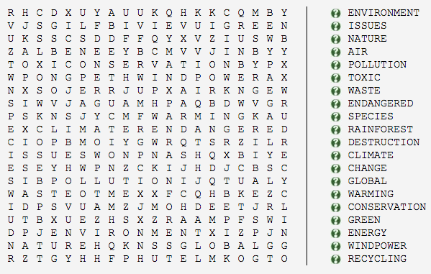
Try to find as many words from the list as you can. Do you know what they mean? If not, check in a dictionary:

Slide 6
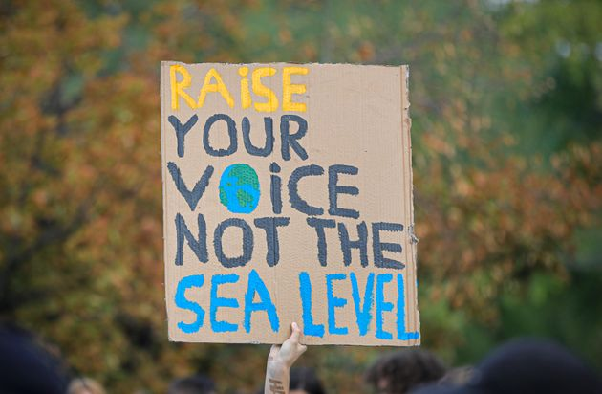
Slogans
Do you know what a slogan is? Explain.
Check out this slogan and try to think of a slogan for climate change that is also fun and catchy!

Slide 7
HOMEWORK
Obnavljanje gradiva
Baš kao i prethodni domaći, i ovaj šaljete fotografisan nastavnici na mejl. U svesku pišete samo rešenja, bez celih rečenica.
Rok za predaju je nedelja, 26.04.
Potrudite se da slikate tako da se sve jasno vidi, kako ne biste morali dva puta da šaljete mejl.
Ne zaboravite da se potpišete i u SUBJECT i na samom papiru tj. u svesci.
Ništa drugo ne treba da šaljete sem narednih zadataka nekoliko urađenih u svesku!
GOOD LUCK!

Slide 8
1. Napiši odgovarajući question tag:
Your birthday is in June, __________?
You didn’t go to her birthday party, ___________?
Peter and John have played football, ___________?
She hasn’t done her homework, _________?

Slide 9
2. What might happen in these situations? Napiši šta se može desiti kao posledica u ovim situacijama koristeći might.
You are bending over to lift something heavy.
A man is driving a car very fast.
A girl is running down the stairs.

Slide 10
3. Reč iz zagrade pretvori u pridev koji se završava na ED ili ING na osnovu značenja rečenice:
David is ____________ (surprise) with his new bike.
This music is so ___________ (relax).
Oh my God! This was so ____________ (embarrass).
She was ___________ (annoy) when she heard the news.
That movie is so ____________ (frighten).
Don’t be ___________ (worry). I am sure everything is alright.

